Slide 1
Principles of Database Systems (CS307) Lecture 14: Storage System and Structure
Ran Cheng
Department of Computer Science and Engineering
Southern University of Science and Technology
Most contents are from slides made by Stéphane Faroult and the authors of Database System Concepts (7th Edition).
Their original slides have been modified to adapt to the schedule of CS307 at SUSTech.
Notes:
In this chapter, I will introduce how to retrieve data from one table. Just from one table. I will introduce how to retrieve data from multiple table in next chapter.

Slide 2
Physical Storage System

Slide 3
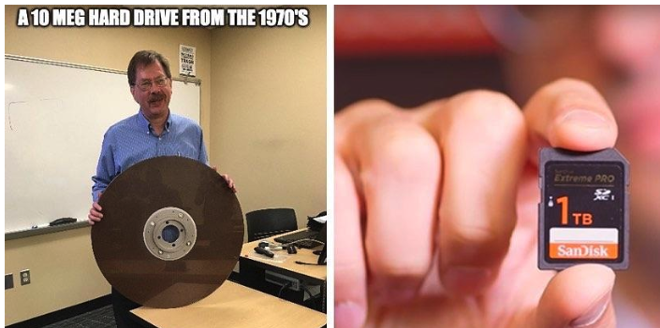
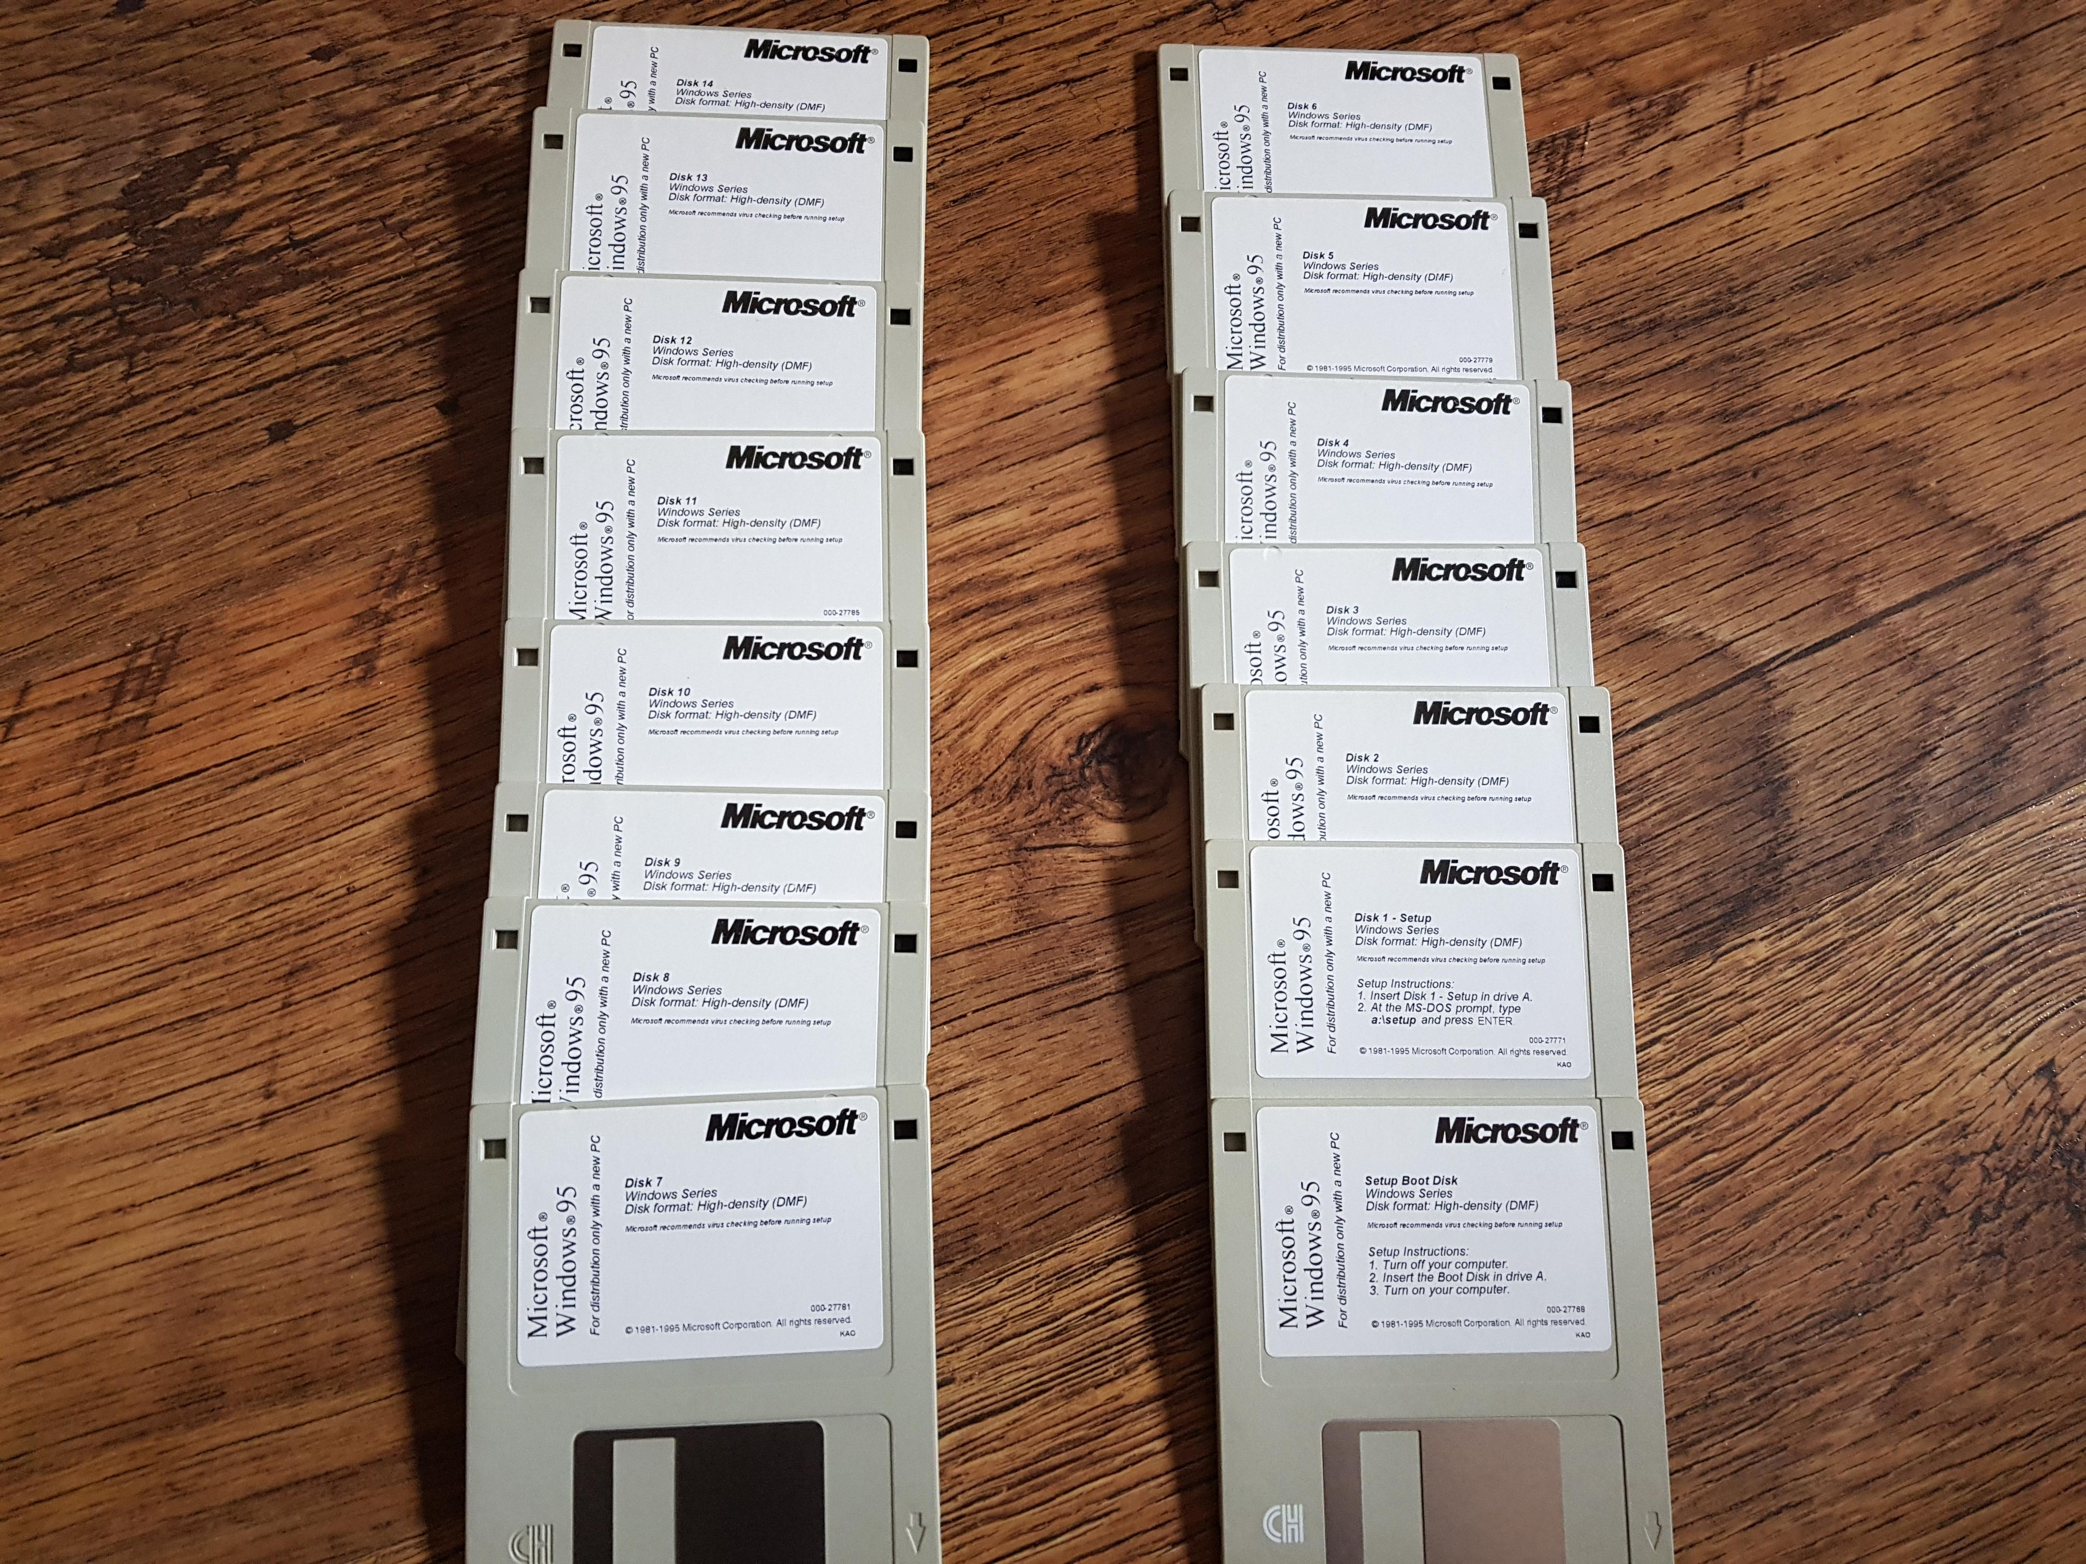
Physical Storage System
The hardware where data is recorded

Slide 4
Classification of Physical Storage Media
Can differentiate storage into:
Volatile storage
Loses contents when power is switched off
Non-volatile storage:
Contents persist even when power is switched off
Includes secondary and tertiary storage, as well as battery-backed up main-memory
Factors affecting choice of storage media include
Speed with which data can be accessed
Cost per unit of data
Reliability

Slide 5
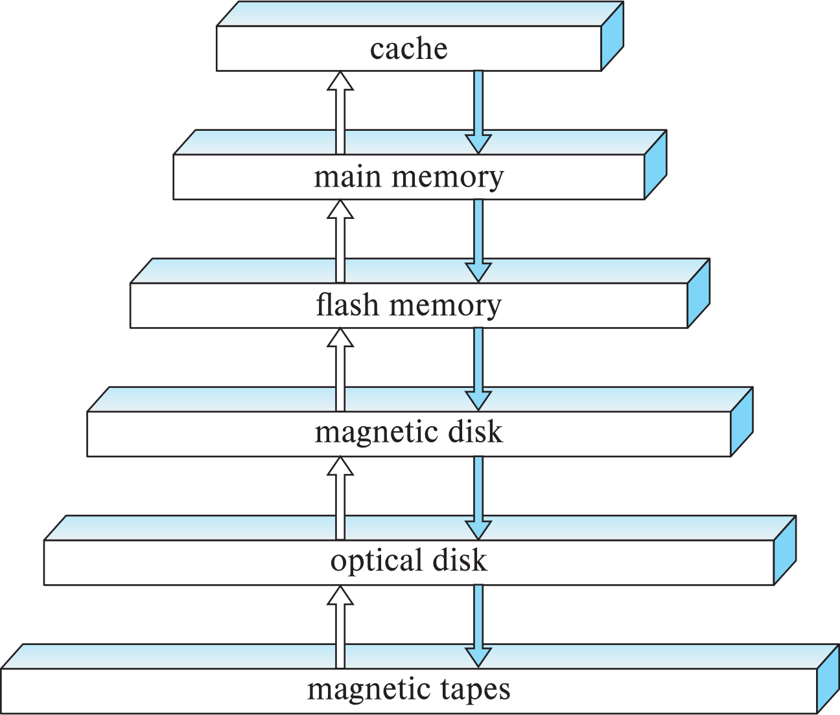
Storage Hierarchy
Primary storage
Fastest media but volatile (cache, main memory).
Secondary storage
Next level in hierarchy, non-volatile, moderately fast access time
… also called on-line storage
E.g., flash memory, magnetic disks
Tertiary storage
Lowest level in hierarchy, non-volatile, slow access time
… also called off-line storage and used for archival storage
E.g., magnetic tape, optical storage
Magnetic tape
Sequential access, 1 to 12 TB capacity
A few drives with many tapes
Juke boxes with petabytes (1000’s of TB) of storage

Slide 6
Storage Interfaces
Disk interface standards families
SATA (Serial ATA)
SATA 3 supports data transfer speeds of up to 6 gigabits/sec
SAS (Serial Attached SCSI)
SAS Version 3 supports 12 gigabits/sec
NVMe (Non-Volatile Memory Express) interface
Works with PCIe connectors to support lower latency and higher transfer rates
Supports data transfer rates of up to 24 gigabits/sec
Disks usually connected directly to computer system, however…
In Storage Area Networks (SAN), a large number of disks are connected by a high-speed network to a number of servers
In Network Attached Storage (NAS) networked storage provides a file system interface using networked file system protocol, instead of providing a disk system interface

Slide 7
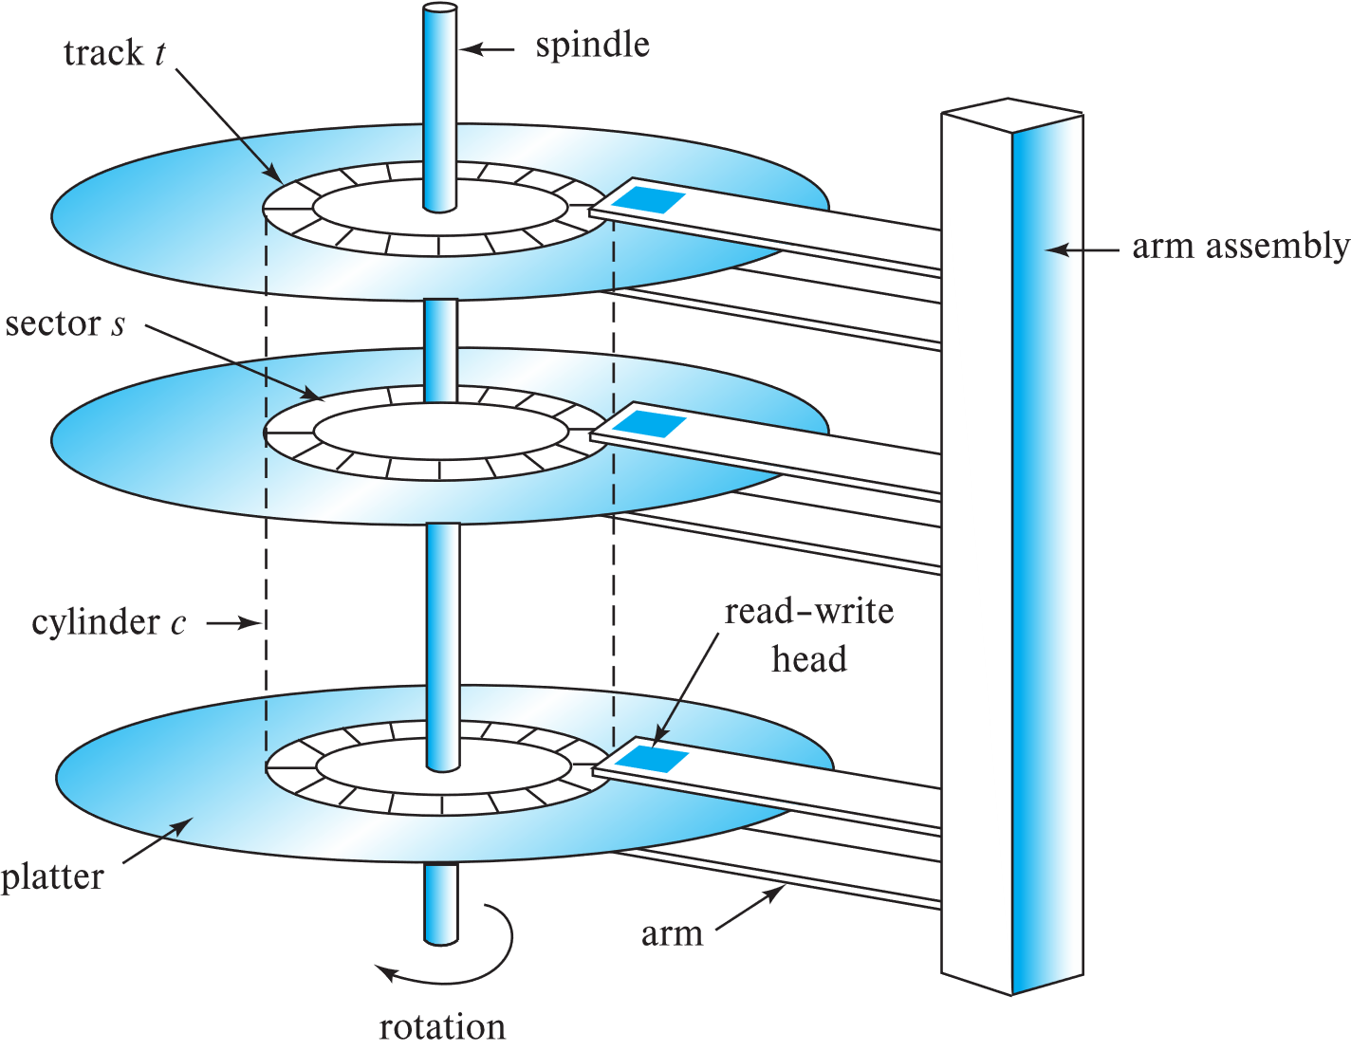
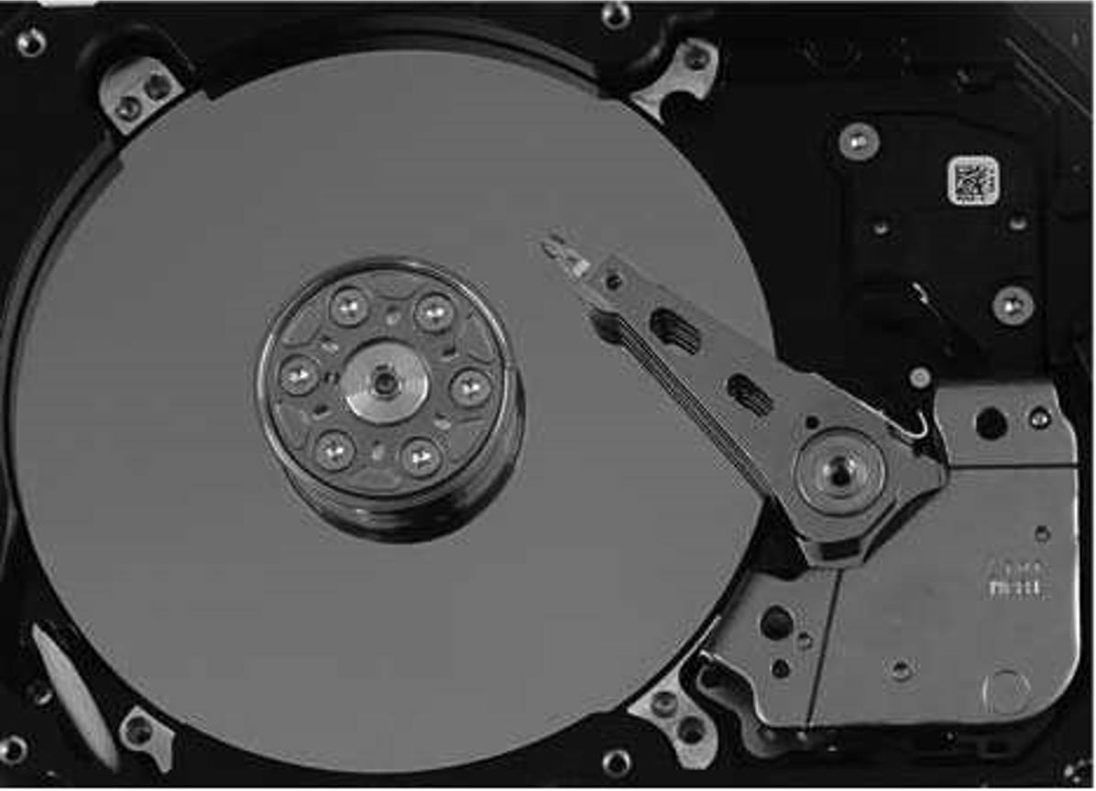
Magnetic Hard Disk Mechanism
Photo of a magnetic disk drive
Schematic diagram of magnetic disk drive

Slide 8
Magnetic Hard Disk Mechanism
Read-write head
Surface of platter divided into circular tracks
Over 50K-100K tracks per platter on typical hard disks
Each track is divided into sectors
A sector is the smallest unit of data that can be read or written.
Sector size typically 512 bytes (modern OS requires 4KB)
Typical sectors per track: 500 to 1000 (on inner tracks) to 1000 to 2000 (on outer tracks)
To read/write a sector
Disk arm swings to position head on right track
Platter spins continually; data is read/written as sector passes under head
Head-disk assemblies
Multiple disk platters on a single spindle (1 to 5 usually)
One head per platter, mounted on a common arm.
Cylinder i consists of ith track of all the platters

Slide 9
Magnetic Hard Disk Mechanism
Disk controller: An interface between the computer system and the disk drive hardware
Accept high-level commands to read or write a sector
Initiate actions such as moving the disk arm to the right track and reading or writing the data
Compute and attach checksums to each sector to verify that data is read back correctly
If data is corrupted, with very high probability stored checksum won’t match recomputed checksum
Ensure successful writing by reading back sector after writing it
Perform remapping of bad sectors

Slide 10
Performance Measures of Disks
Access time: The time it takes from when a read or write request is issued to when data transfer begins. Consists of:
Seek time – time it takes to reposition the arm over the correct track.
Average seek time is 1/2 the worst case seek time.
Would be 1/3 if all tracks had the same number of sectors, and we ignore the time to start and stop arm movement
4 to 10 milliseconds on typical disks
Rotational latency – time it takes for the sector to be accessed to appear under the head.
4 to 11 milliseconds on typical disks (5400 to 15000 r.p.m.)
Average latency is 1/2 of the above latency.
Overall latency is 5 to 20 msec depending on disk model
Data-transfer rate: The rate at which data can be retrieved from or stored to the disk.
25 to 200 MB per second max rate, lower for inner tracks

Slide 11
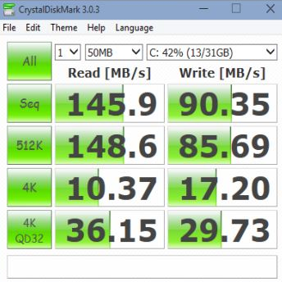
Performance Measures of Disks
Disk block is a logical unit for storage allocation and retrieval
4 to 16 kilobytes typically
Smaller blocks: more transfers from disk
Larger blocks: more space wasted due to partially filled blocks
Sequential access pattern
Successive requests are for successive disk blocks
Disk seek required only for first block
Random access pattern
Successive requests are for blocks that can be anywhere on disk
Each access requires a seek
Transfer rates are low since a lot of time is wasted in seeks
I/O operations per second (IOPS)
Number of random block reads that a disk can support per second
50 to 200 IOPS on current generation magnetic disks

Slide 12
Performance Measures of Disks
Mean time to failure (MTTF) – the average time the disk is expected to run continuously without any failure.
Typically, 3 to 5 years
Probability of failure of new disks is quite low, corresponding to a “theoretical MTTF” of 500,000 to 1,200,000 hours for a new disk
E.g., an MTTF of 1,200,000 hours for a new disk means that given 1000 relatively new disks, on an average one will fail every 1200 hours
MTTF decreases as disk ages

Slide 13
Flash Storage
NOR flash vs NAND flash
NAND flash
Used widely for storage, cheaper than NOR flash
Requires page-at-a-time read (page: 512 bytes to 4 KB)
20 to 100 microseconds for a page read
Not much difference between sequential and random read
Page can only be written once
Must be erased to allow rewrite
Solid state disks (SSD)
Use standard block-oriented disk interfaces, but store data on multiple flash storage devices internally
Transfer rate of up to 500 MB/sec using SATA, and up to 3 GB/sec using NVMe PCIe

Slide 14
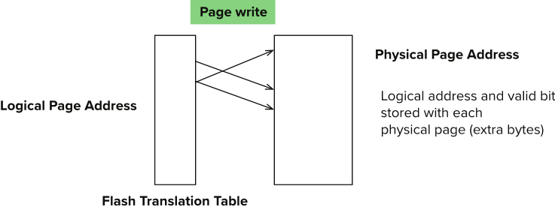
Flash Storage
Erase happens in units of erase block
Takes 2 to 5 millisecs
Erase block typically 256 KB to 1 MB (128 to 256 pages)
Remapping of logical page addresses to physical page addresses avoids waiting for erase
Flash translation table tracks mapping
Also stored in a label field of flash page
Remapping carried out by flash translation layer
After 100,000 to 1,000,000 erases, erase block becomes unreliable and cannot be used
Wear leveling

Slide 15
SSD Performance Metrics
Random reads/writes per second
Typical 4KB reads: 10,000 reads per second (10,000 IOPS)
Typical 4KB writes: 40,000 IOPS
SSDs support parallel reads
Typical 4KB reads:
100,000 IOPS with 32 requests in parallel (QD-32) on SATA
350,000 IOPS with QD-32 on NVMe PCIe
Typical 4KB writes:
100,000 IOPS with QD-32, even higher on some models
Data transfer rate for sequential reads/writes
400 MB/sec for SATA3, 2 to 3 GB/sec using NVMe PCIe
Hybrid disks: Combine small amount of flash cache with larger magnetic disk

Slide 16
Storage Class Memory
3D-XPoint memory technology pioneered by Intel
Available as Intel Optane
SSD interface shipped from 2017
Allows lower latency than flash SSDs
Non-volatile memory interface announced in 2018
Supports direct access to words, at speeds comparable to main-memory speeds

Slide 17
Magnetic Tapes
Hold large volumes of data and provide high transfer rates
Few GB for DAT (Digital Audio Tape) format, 10-40 GB with DLT (Digital Linear Tape) format, 100 GB+ with Ultrium format, and 330 GB with Ampex helical scan format
Transfer rates from few to 10s of MB/s
Tapes are cheap, but cost of drives is very high
Very slow access time in comparison to magnetic and optical disks
limited to sequential access.
Some formats (Accelis) provide faster seek (10s of seconds) at cost of lower capacity
Used mainly for backup, for storage of infrequently used information, and as an off-line medium for transferring information from one system to another.
Tape jukeboxes used for very large capacity storage
Multiple petabytes (10¹⁵ bytes)

Slide 18
RAID
RAID: Redundant Arrays of Independent Disks
Disk organization techniques that manage a large numbers of disks, providing a view of a single disk of
high capacity and high speed by using multiple disks in parallel
high reliability by storing data redundantly, so that data can be recovered even if a disk fails
The chance that some disk out of a set of N disks will fail is much higher than the chance that a specific single disk will fail.
E.g., a system with 100 disks, each with MTTF of 100,000 hours (approx. 11 years), will have a system MTTF of 1000 hours (approx. 41 days)
Techniques for using redundancy to avoid data loss are critical with large numbers of disks

Slide 19
Improvement of Reliability via Redundancy
Redundancy – Store extra information that can be used to rebuild information lost in a disk failure
E.g., Mirroring (or shadowing)
Duplicate every disk. Logical disk consists of two physical disks.
Every write is carried out on both disks
Reads can take place from either disk
If one disk in a pair fails, data still available in the other
Data loss would occur only if a disk fails, and its mirror disk also fails before the system is repaired
Probability of combined event is very small
Except for dependent failure modes such as fire or building collapse or electrical power surges
Mean time to data loss depends on mean time to failure, and mean time to repair
E.g., MTTF of 100,000 hours, mean time to repair of 10 hours gives mean time to data loss of 500*106 hours (or 57,000 years) for a mirrored pair of disks (ignoring dependent failure modes)

Slide 20
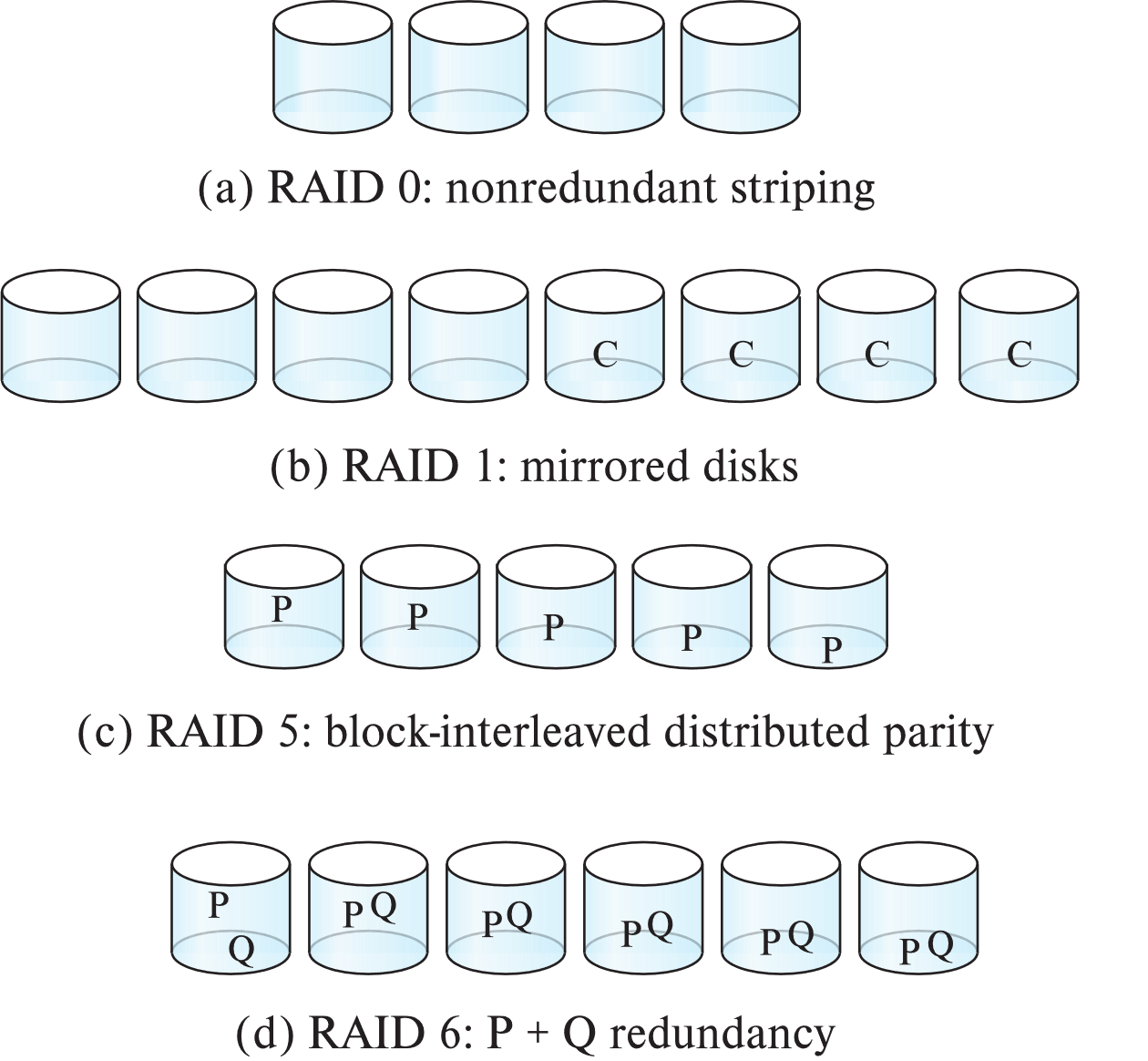
RAID Levels
Schemes to provide redundancy at lower cost by using disk striping (条带) combined with parity bits （奇偶校验）
Different RAID organizations, or RAID levels, have differing cost, performance and reliability characteristics
RAID 0: Block striping; non-redundant
RAID 1: Mirrored disks with block striping
…
RAID 10: Combination of striping and mirroring
RAID 5: Block-interleaved distributed parity
RAID 6: P+Q Redundancy scheme

Slide 21
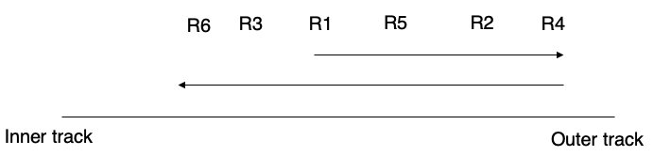
Optimization of Disk-Block Access
Buffering
In-memory buffer to cache disk blocks
Read-ahead
Read extra blocks from a track in anticipation that they will be requested soon
Disk-arm-scheduling algorithms
Re-order block requests so that disk arm movement is minimized
E.g., elevator algorithm

Slide 22
Optimization of Disk-Block Access
File organization
Allocate blocks of a file in as contiguous a manner as possible
Allocation in units of extents
Files may get fragmented
E.g., if free blocks on disk are scattered, and newly created file has its blocks scattered over the disk
Sequential access to a fragmented file results in increased disk arm movement
Some systems have utilities to defragment the file system, in order to speed up file access
Non-volatile write buffers
Temporarily store the written data
… and immediately notifies the OS that writing is completed without errors
Write data into the disk when idle
… with some optimizations

Slide 23
(Logical) Data Storage Structure

Slide 24
File Organization
The database is stored as a collection of files
Each file is a sequence of records
A record is a sequence of fields.
One approach
Assume record size is fixed
Each file has records of one particular type only
Different files are used for different relations
* This case is easiest to implement; we will consider variable length records later
We assume that records are smaller than a disk block

Slide 25
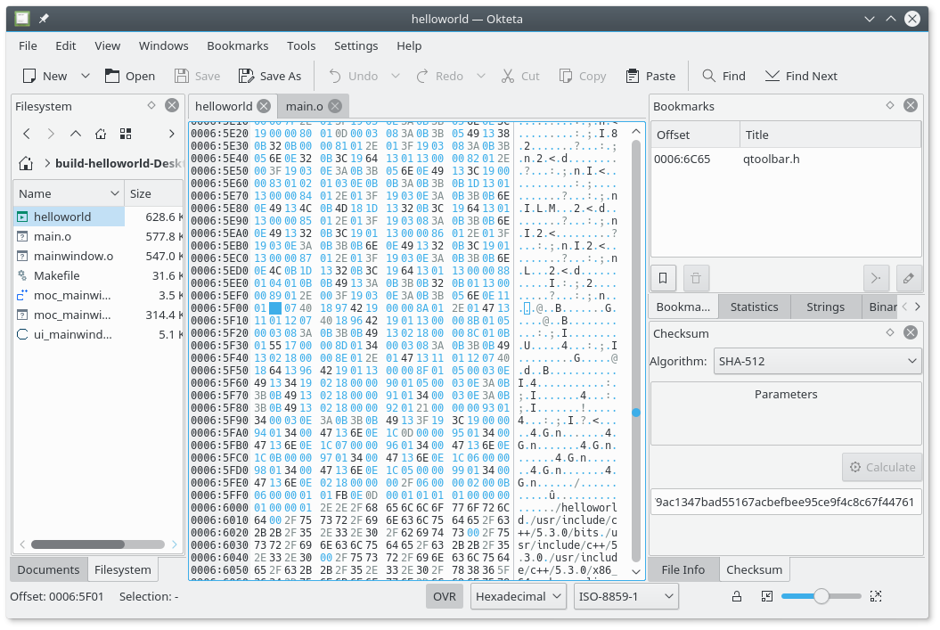
File Organization
Bitmap of a file
https://apps.kde.org/okteta/

Slide 26
File Organization
Goals: Time and Space
Support CURD operations as fast as possible
Save storage space as much as possible
Also, to some extent, maintain data integrity

Slide 27
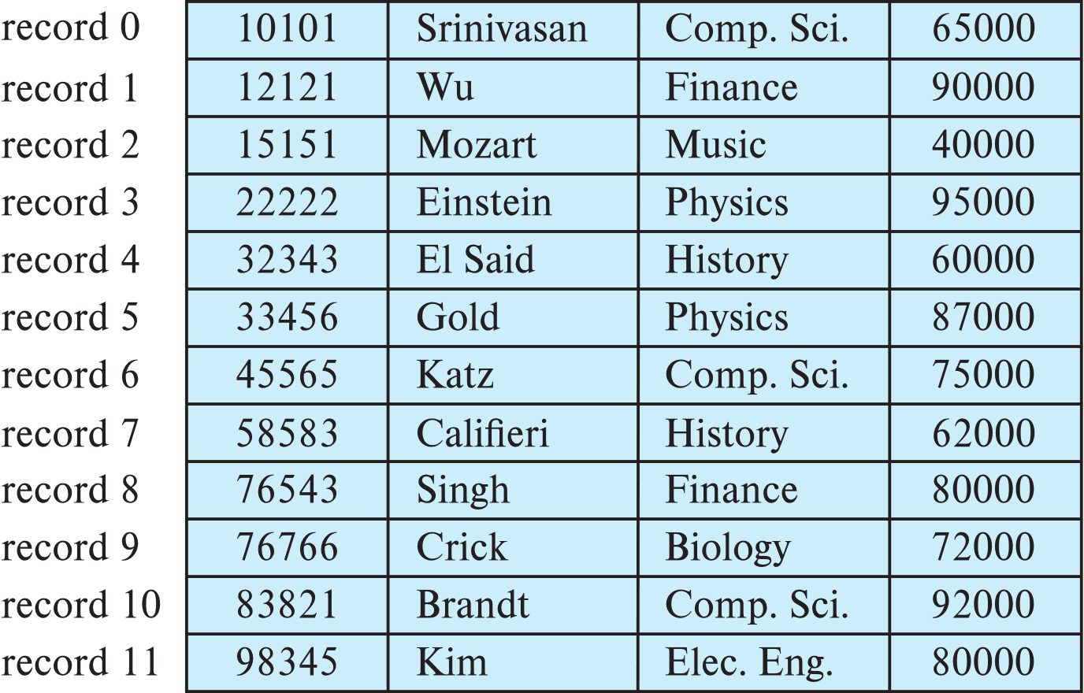
Fixed-Length Records
Simple approach:
Store record i starting from byte n*(i – 1), where n is the size of each record
Record access is simple, but records may cross blocks
Modification: do not allow records to cross block boundaries

Slide 28
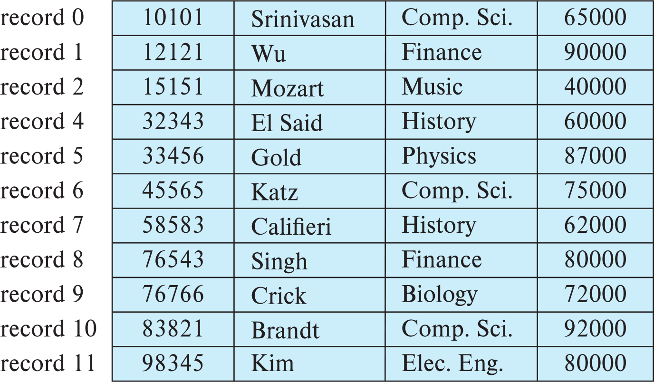
Fixed-Length Records
Deletion of record i
Way #1: move records i + 1, . . ., n to i, . . . , n – 1

Slide 29
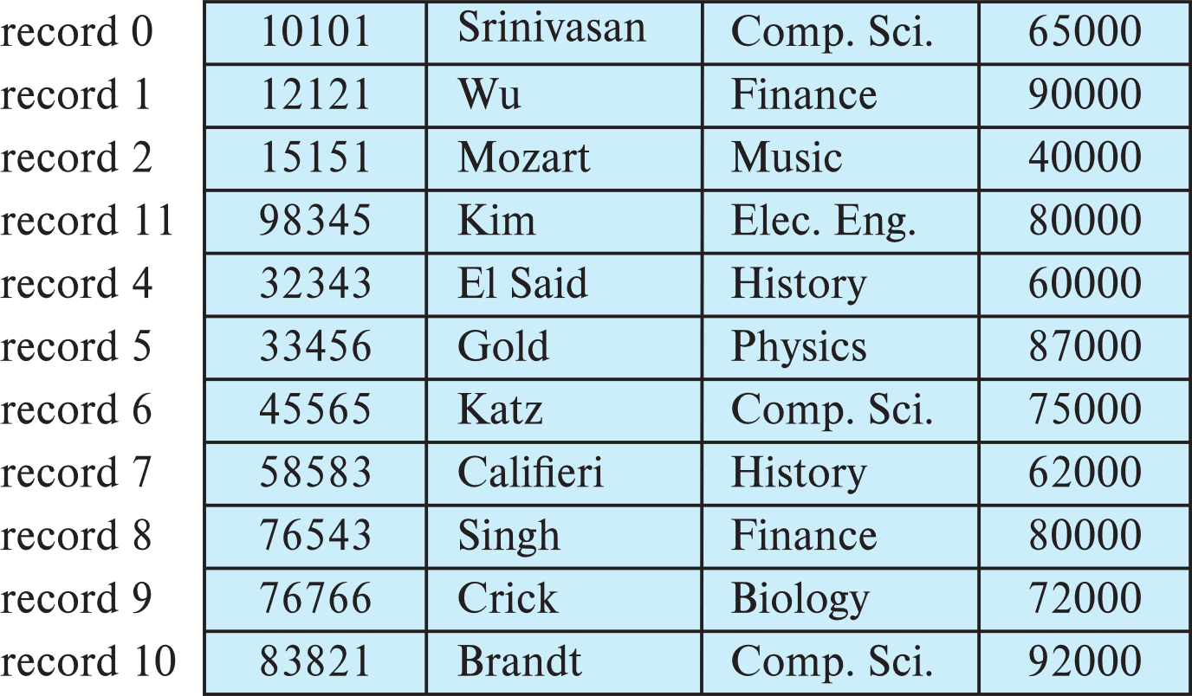

Fixed-Length Records
Deletion of record i
Way #2: move record n to i
Record 3 is removed and replaced by record 11

Slide 30
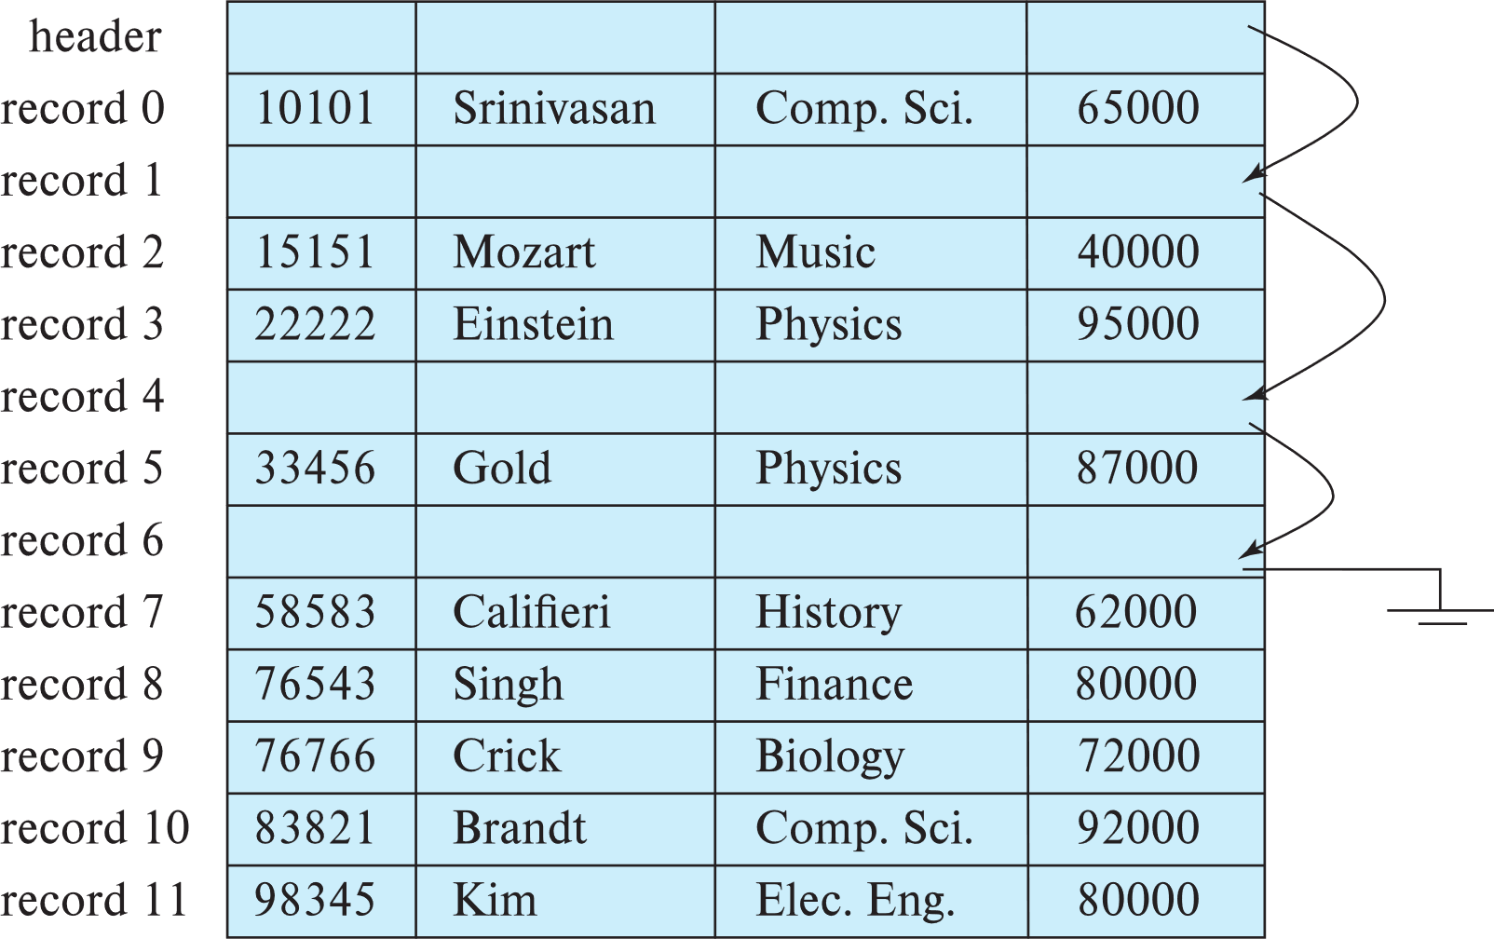
Fixed-Length Records
Deletion of record i
Way #3: Do not move records, but link all free records on a free list

Slide 31
Variable-Length Records
Variable-length records arise in database systems in several ways:
Storage of multiple record types in a file.
Record types that allow variable lengths for one or more fields such as strings (varchar)
Record types that allow repeating fields (used in some older data models).
Problem with variable-length records
How can we retrieve the data in an easy way without wasting too much space
varchar(1000): do we really need to allocate 1000 bytes for this field, even if most of the actual data items only costs less than 10 bytes?

Slide 32
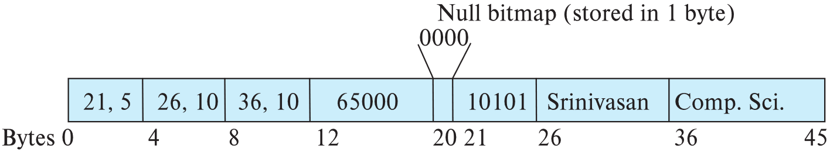
Variable-Length Records
Attributes are stored in order
Variable length attributes represented by fixed size (offset, length), with actual data stored after all fixed length attributes
Null values represented by null-value bitmap
offsets and lengths
The actual data (“10101” in varchar type)

Slide 33
Variable-Length Records
Slotted page header contains:
number of record entries
end of free space in the block
location and size of each record
Records can be moved around within a page to keep them contiguous with no empty space between them; entry in the header must be updated
Pointers should not point directly to records — instead, they should point to the entry for the record in header
Page size is usually aligned with the disk block size (4KB-8KB)

Slide 34
Storing Large Objects
E.g., BLOB/CLOB types
BLOB: Binary Large OBject
CLOB: Character Large OBject
Records must be smaller than pages
Alternatives:
Store as files in file systems
Store as files managed by databases
Break into pieces and store in multiple tuples in separate relation
PostgreSQL TOAST

Slide 35
Organization of Records in Files
Heap – records can be placed anywhere in the file where there is space
Sequential – store records in sequential order, based on the value of the search key of each record
Multitable clustering file organization
Records of several different relations can be stored in the same file
Motivation: store related records on the same block to minimize I/O
B+-tree file organization
Ordered storage even with inserts/deletes
Hashing – a hash function computed on search key; the result specifies in which block of the file the record should be placed

Slide 36
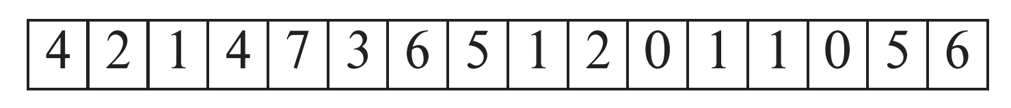
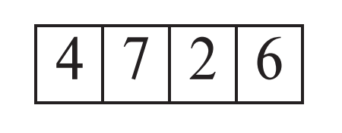
Heap File Organization
Records can be placed anywhere in the file where there is free space
Records usually do not move once allocated
Important to be able to efficiently find free space within file
Free-space map
Array with 1 entry per block. Each entry is a few bits to a byte, and records fraction of block that is free
In example below, 3 bits per block, value divided by 8 indicates fraction of block that is free
Can have second-level free-space map
In example below, each entry stores maximum from 4 entries of first-level free-space map
Free space map written to disk periodically, OK to have wrong (old) values for some entries (will be detected and fixed)

Slide 37
Sequential File Organization
Suitable for applications that require sequential processing of the entire file
The records in the file are ordered by a search-key

Slide 38
Sequential File Organization
Deletion – Use pointer chains
Insertion – Locate the position where the record is to be inserted
if there is free space insert there
if no free space, insert the record in an overflow block
In either case, pointer chain must be updated
Need to reorganize the file from time to time to restore sequential order

Slide 39
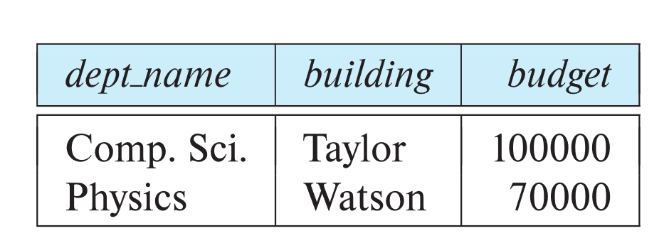
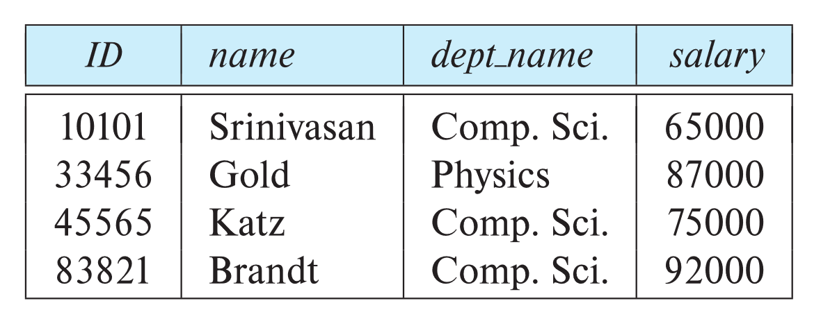
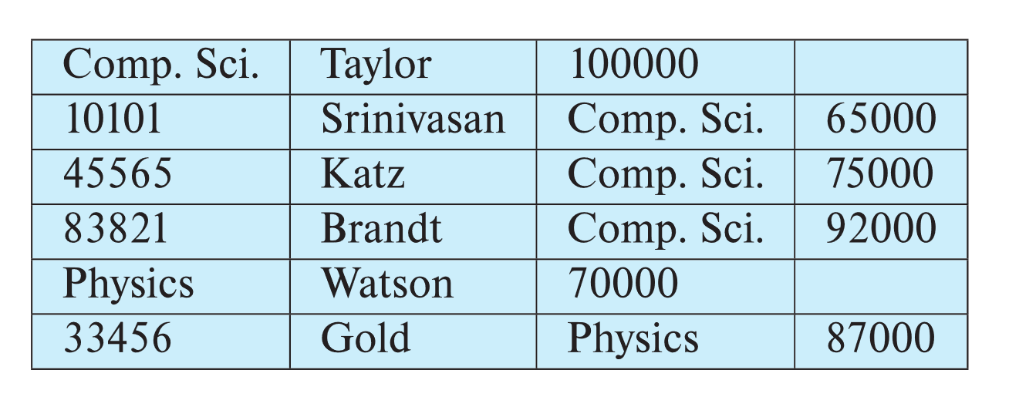
Multitable Clustering File Organization
Store several relations in one file using a multitable clustering file organization
Good for queries involving:
department ⨝ instructor
or: one single department and its instructors (one-to-many correspondense)
Bad for queries involving only department
Results in variable size records
Can add pointer chains to link records of a particular relation
Bad for large databases
where other operations than joins are required
department
instructor
Multitable clustering of department and instructor

Slide 40
Partitioning
Table partitioning: Records in a relation can be partitioned into smaller relations that are stored separately
E.g., transaction relation may be partitioned into transaction_2018, transaction_2019, etc.
Queries written on transaction must access records in all partitions
Unless query has a selection such as year=2019, in which case only one partition in needed
Partitioning
Reduces costs of some operations such as free space management
Allows different partitions to be stored on different storage devices
E.g., transaction partition for current year on SSD, for older years on magnetic disk

Slide 41
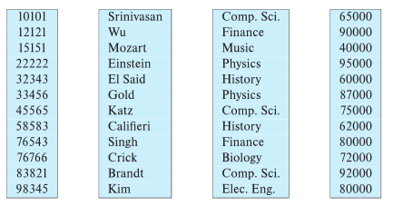
Column-Oriented Storage
(Also known as columnar representation)
Store each attribute of a relation separately

Slide 42
Column-Oriented Storage
Benefits:
Reduced IO if only some attributes are accessed
Improved CPU cache performance
Improved compression
Data in the same type can be compressed more efficiently
Vector processing on modern CPU architectures
Drawbacks
Cost of tuple reconstruction from columnar representation
Cost of tuple deletion and update
Cost of decompression

Slide 43
Column-Oriented Storage
Columnar representation found to be more efficient for decision support than row-oriented representation
Traditional row-oriented representation preferable for transaction processing
Some databases support both representations
Called hybrid row/column stores

Slide 44
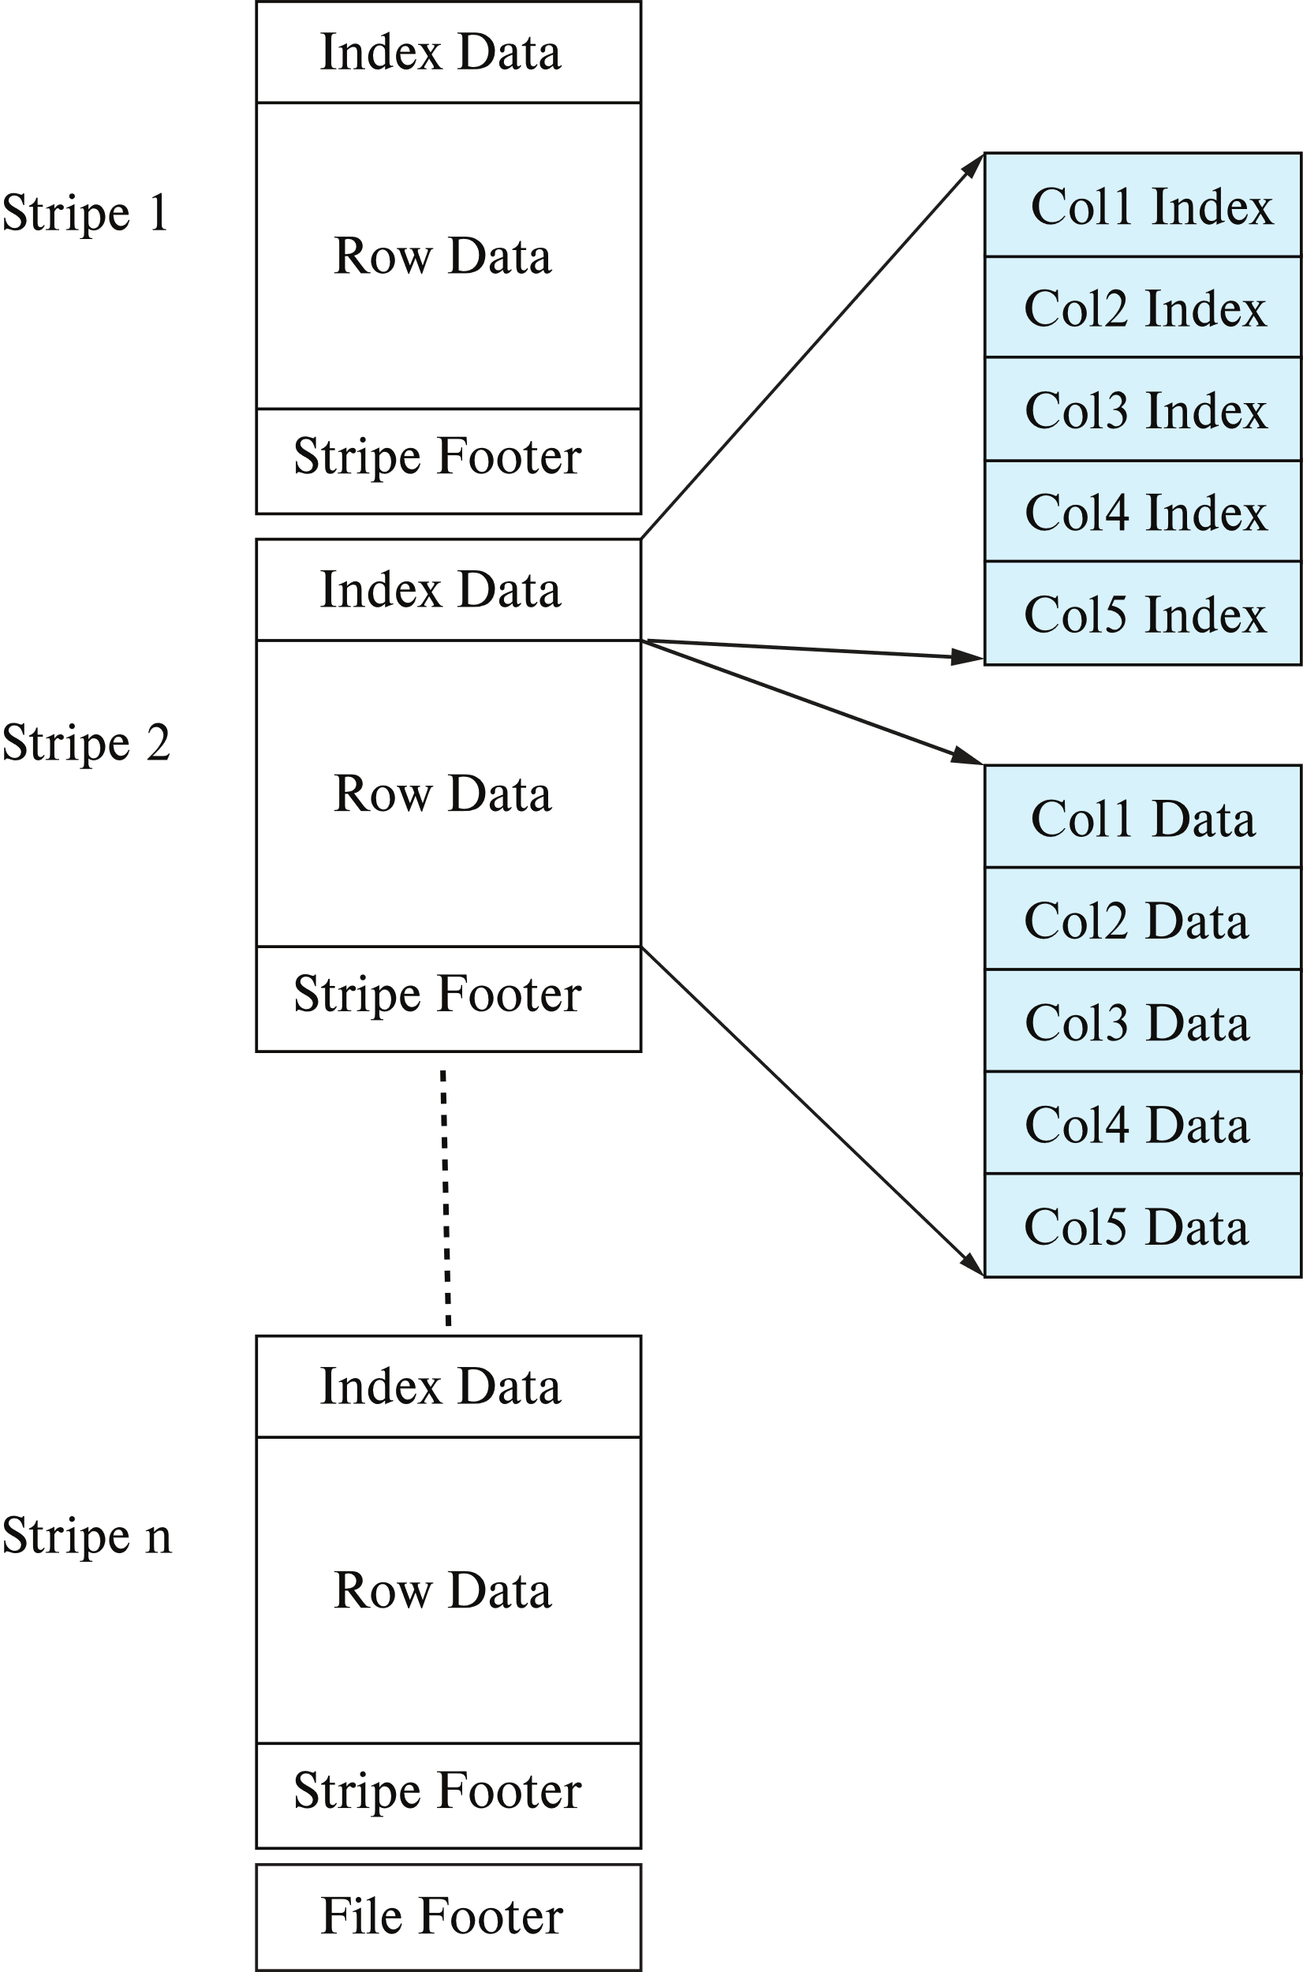
Column-Oriented Storage
ORC (Optimized Row Columnar) File Format
File format with columnar storage inside file
Details if you are interested in big data processing:
https://cwiki.apache.org/confluence/display/hive/languagemanual+orc

Slide 45
Data Dictionary Storage
The Data dictionary (also called system catalog) stores metadata
… that is, data about data – “meta” means “of”
It includes
Information about relations
Names of relations
Names, types and lengths of attributes of each relation
Names and definitions of views
Integrity constraints
User and accounting information, including passwords
Statistical and descriptive data
Number of tuples in each relation

Slide 46
Data Dictionary Storage
It includes (continue)
Physical file organization information
How relation is stored (sequential/hash/…)
Physical location of relation
Information about indices/indexes
(we will learn it later)

Slide 47
Relational Representation of System Metadata
An example of the relational representation of the metadata
Relational representation on disk
Specialized data structures designed for efficient access, in memory
Different DBMS may have their own implementation

Slide 48
Storage Access
Blocks are units of both storage allocation and data transfer
Database system seeks to minimize the number of block transfers between the disk and memory
We can reduce the number of disk accesses by keeping as many blocks as possible in main memory
Buffer: Portion of main memory available to store copies of disk blocks
Buffer Manager: Subsystem responsible for allocating buffer space in main memory

Slide 49
Self Study
Database System Concepts , 7th Edition
Chapter 13.5 “Database Buffer”

